Slide 1

Audio Video Indexing And Retrieval
By
Chandra Shekhar Sengupta
Roll - 11IT61K14,
MTech (ICT )
Under the guidance of
Prof. K. S. Rao
School of Information Technology,
INDIAN INSTITUTE OF TECHNOLOGY KHARAGPUR

Slide 2
Case Study 1
Video File 1

Slide 3
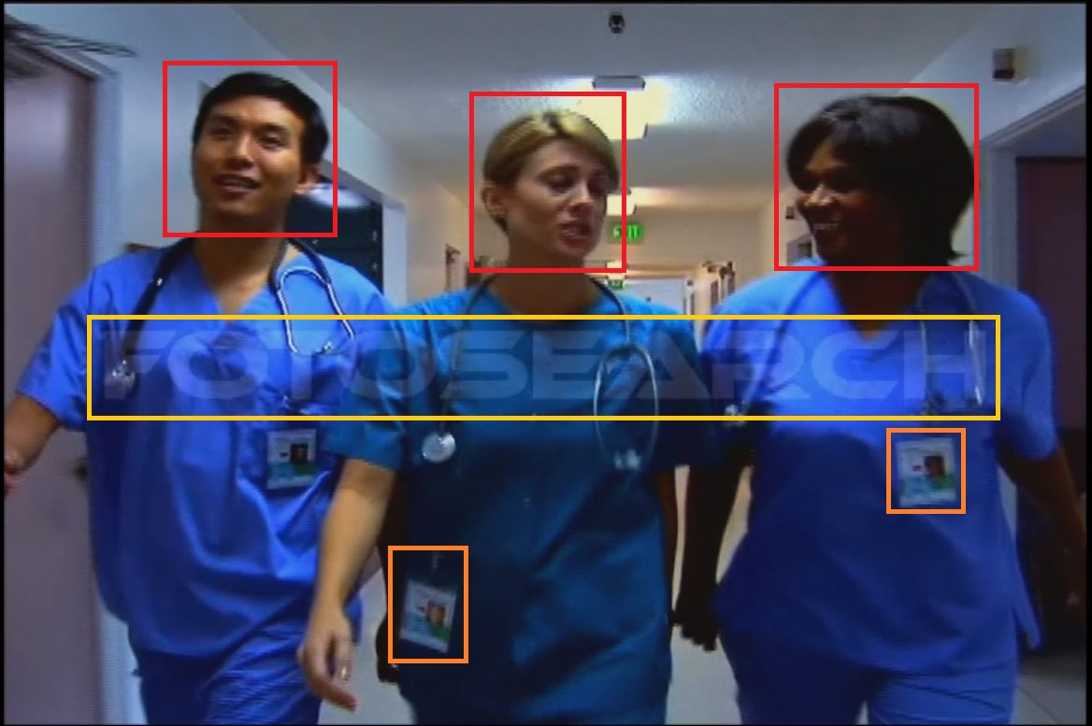
Image Information

Slide 4
Indexing Information
Acoustic Information → Background Music
Image Information →
Face Detection : 3 person
OCR Text : fotosearch
Other objects : ID card
Speech Information → none

Slide 5
Case Study 2
Video File 2

Slide 6
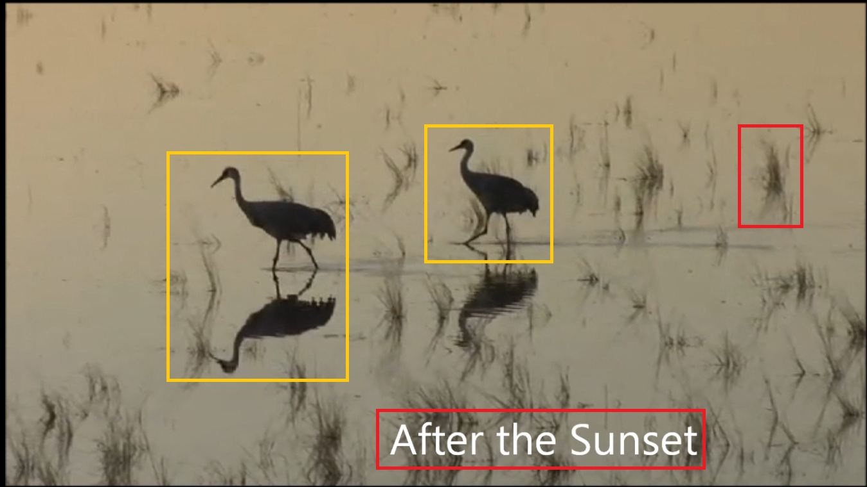
Image Information

Slide 7
Indexing Information
Acoustic Information → Background Sound
Image Information →
Face Detection : none
OCR Text : After the sunset
Other objects : Cranes, Grass, Reflection, Water
Speech Information → none

Slide 8
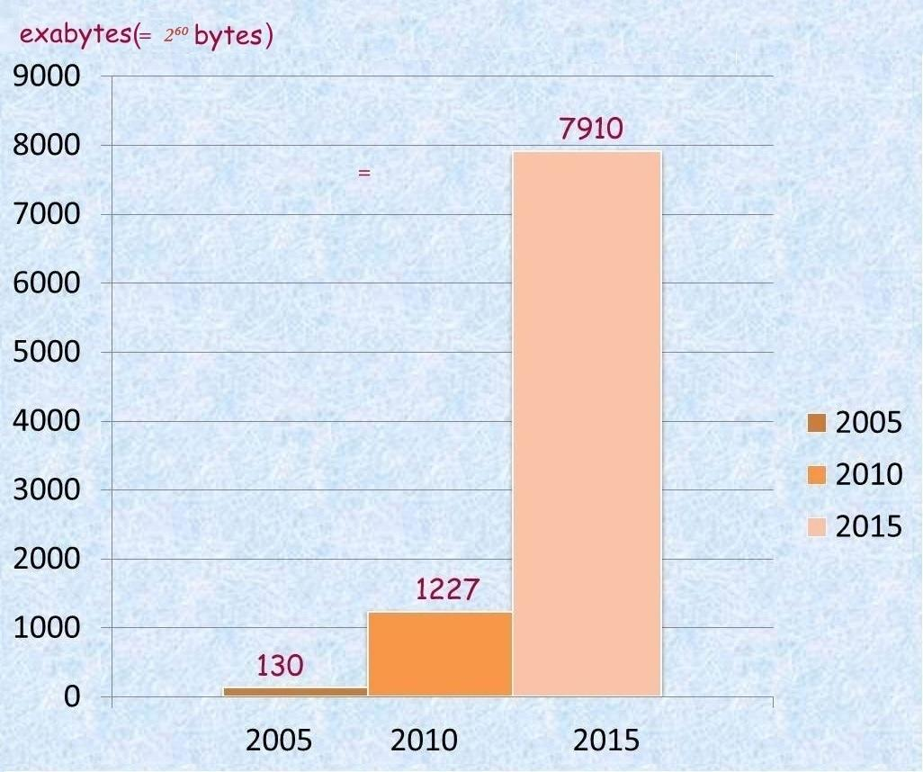
Global Data Volume
It would take 13,513 planes
(Boeing 747 aircraft) to transport one exabyte of data if we store data in DVDs.

Slide 9
Few Facts about data on Internet
Using DVDs to move the data collected globally in 2010 would require a fleet of more than 16 million jumbo jets.
Internet video & Audio will account for 61% of total Internet data by 2015.
In 2010, Google had only indexed .004% of the data on the internet.

Slide 10
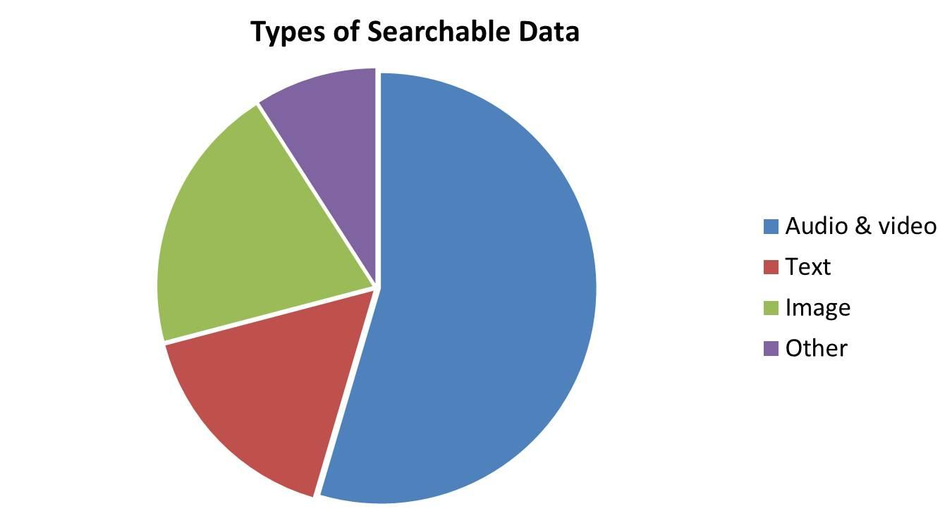
Ratio of Searchable Data
Other
Image
Audio & Video
Text

Slide 11
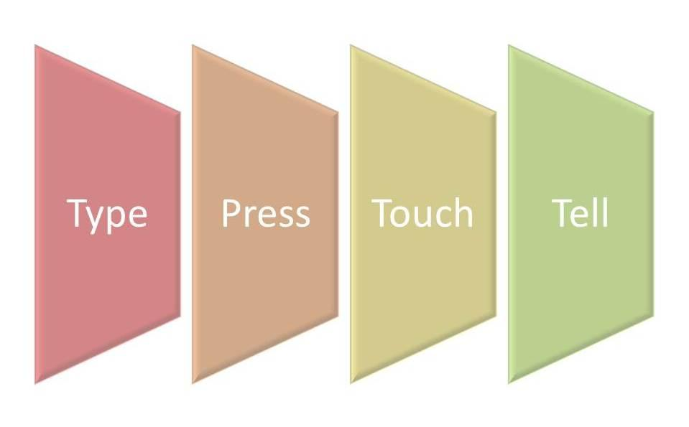
Input method for Devices

Slide 12
Motivation & Objectives
Current web search engines do not searches into audio, video files.
Manually entered tag may not be relevant
Huge amount of data is not searchable yet.
To come up with an audio,video indexing & retrieval technique which indexes relevant information out of audio, video file .

Slide 13
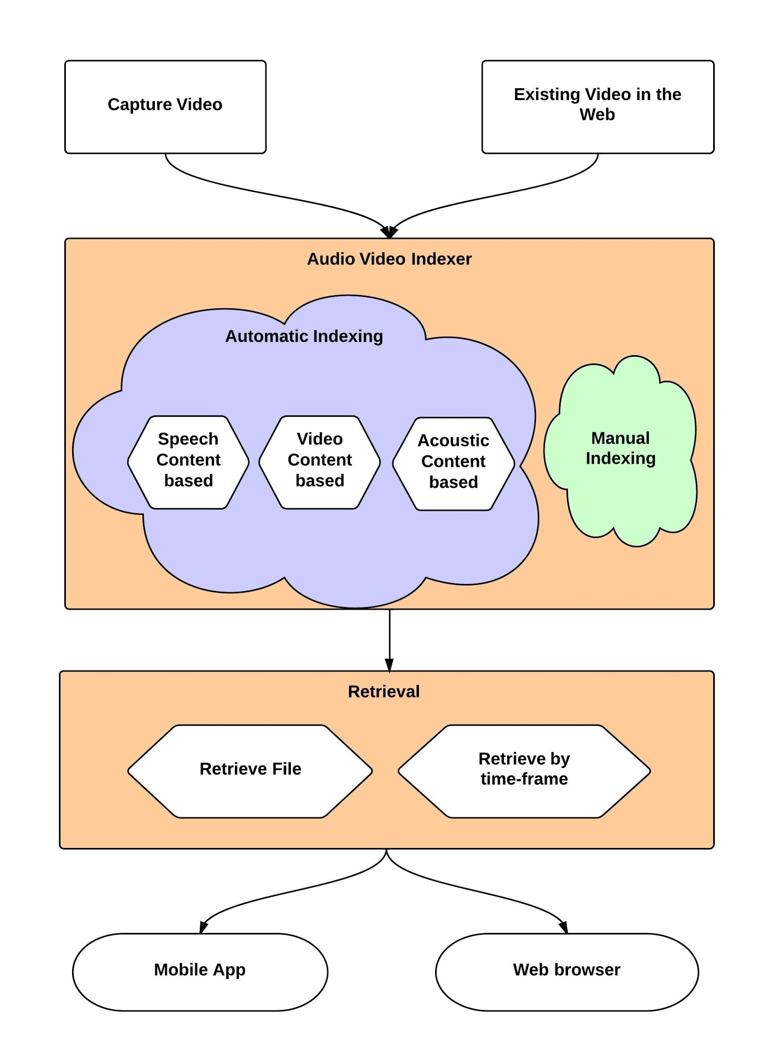
New Approach
Our Approach

Slide 14
Survey of Existing work
Audio Indexing and Retrieval Techniques
Informative metadata / tags based Audio Indexing System
Speech Recognition based Audio Indexing System
Content-Based Audio Indexing and Retrieval
Vector-Based Audio Indexing and Retrieval

Slide 15
Research Projects on Speech Indexing & Retrieval
MUVIS: A framework for management (indexing, browsing, querying, summarisation, etc.) of the multimedia collections such as audio/video clips and still images.
Rough’n’Ready: which indexes speech data, creates a structural summarization, and provides tools for browsing the stored data.
SpeechBot: a Speech Recognition based Audio Indexing System for the Web.

Slide 16
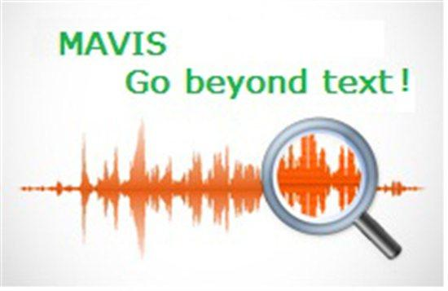


Commercially Available
Audio Data Indexing & Retrieval
Google
Audio
Indexing
HP
Autonomy
Microsoft

Slide 17
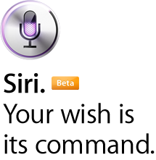
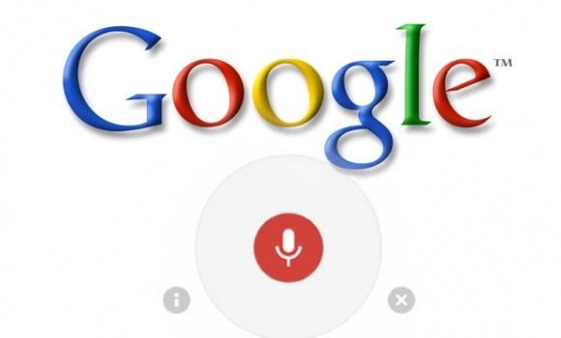

Voice Data Search
Apple
Google
Voice Search
Vlingo
Voice Search

Slide 18
Differentiating factor of Our Approach
1. Integration of index keys available from three major components of a video/audio file
2. Index key determination algorithm(tag cloud) based on relevancy
3. Integration with YouTube and existing video sharing websites to be able to index existing contents around the web
4. Categorization of Index keys based on Acoustic information
5. Index keys with time frame
6. Retrieval from mobile device and web
7. Retrieval by time frame
8. Retrieval by video input

Slide 19
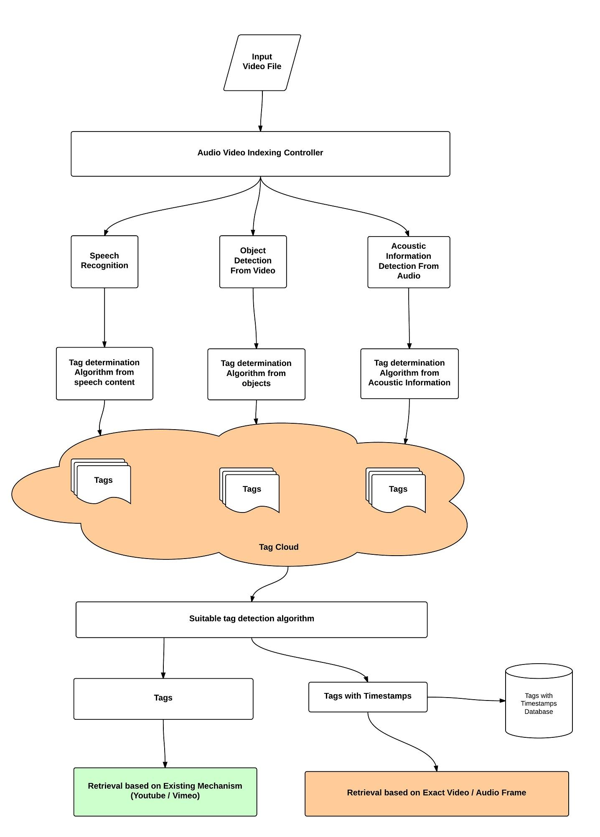
Overall
Architecture

Slide 20
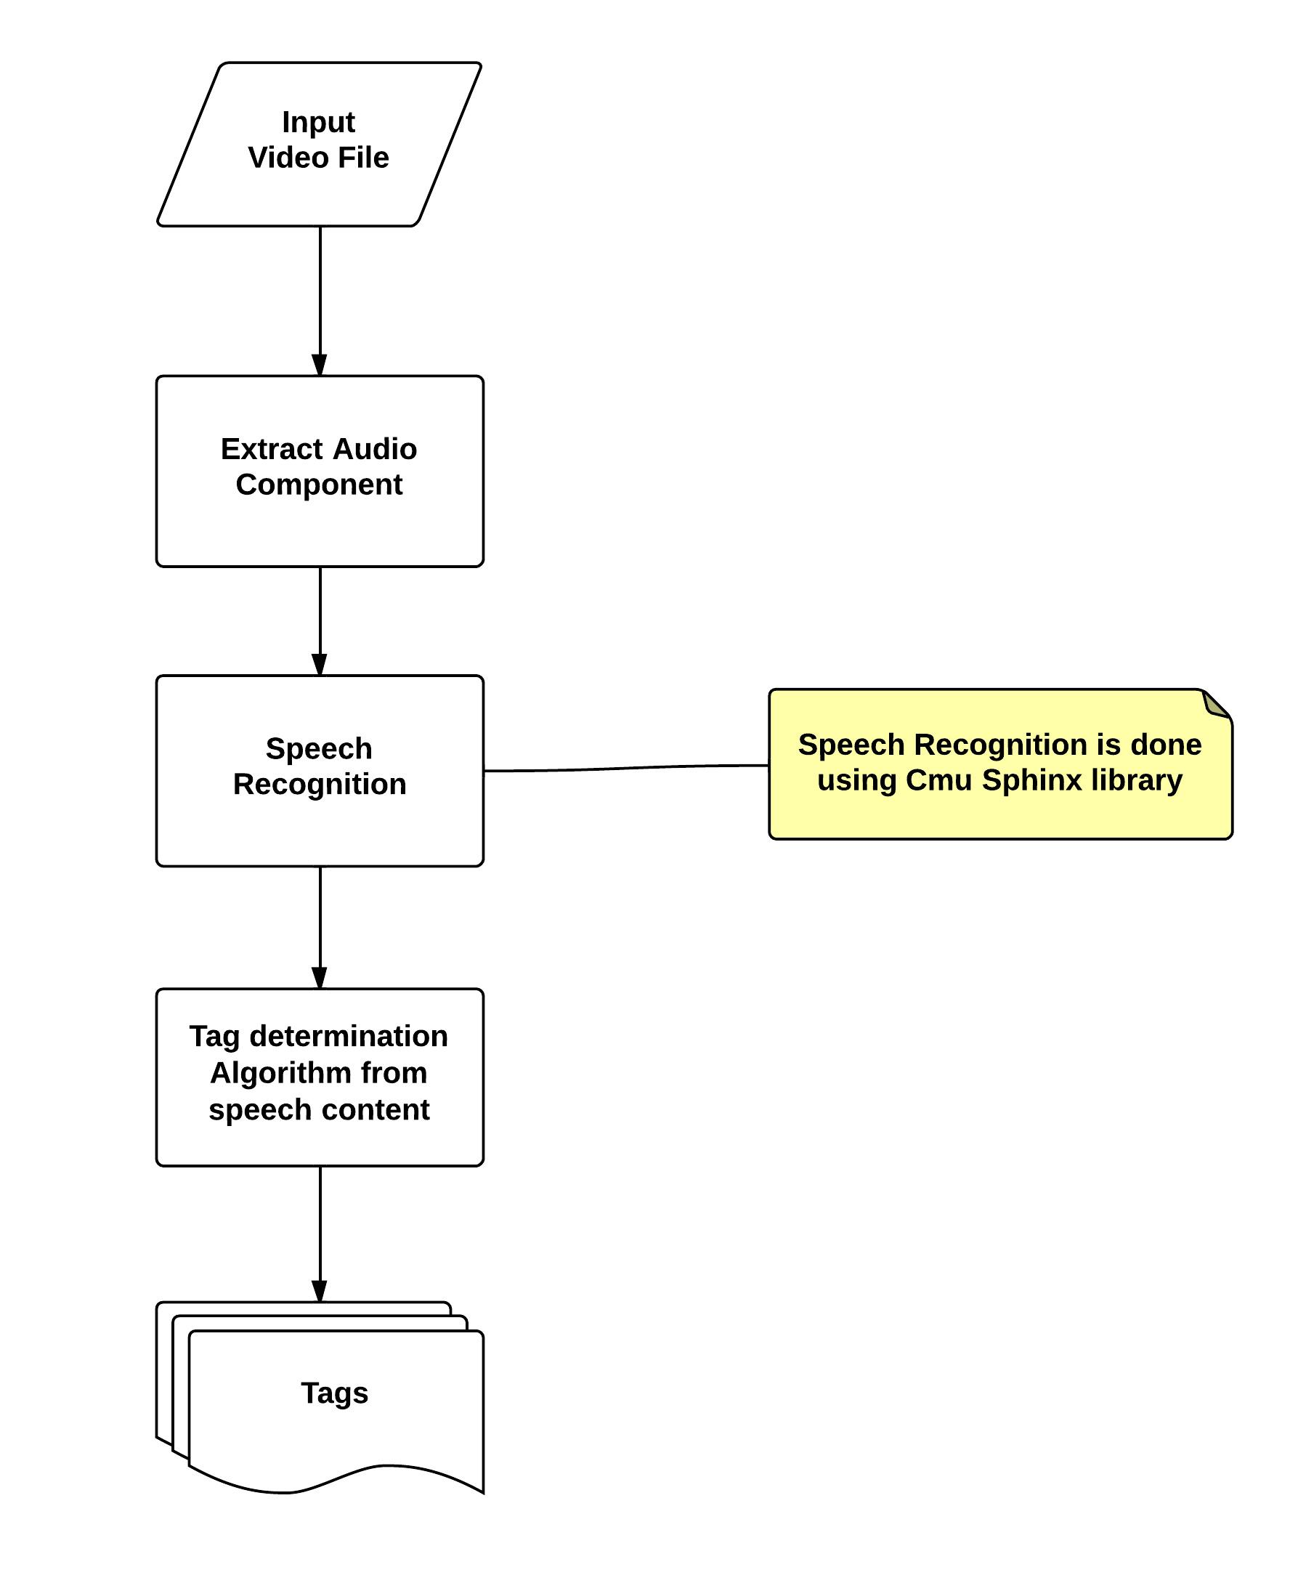
Speech
Recognition

Slide 21
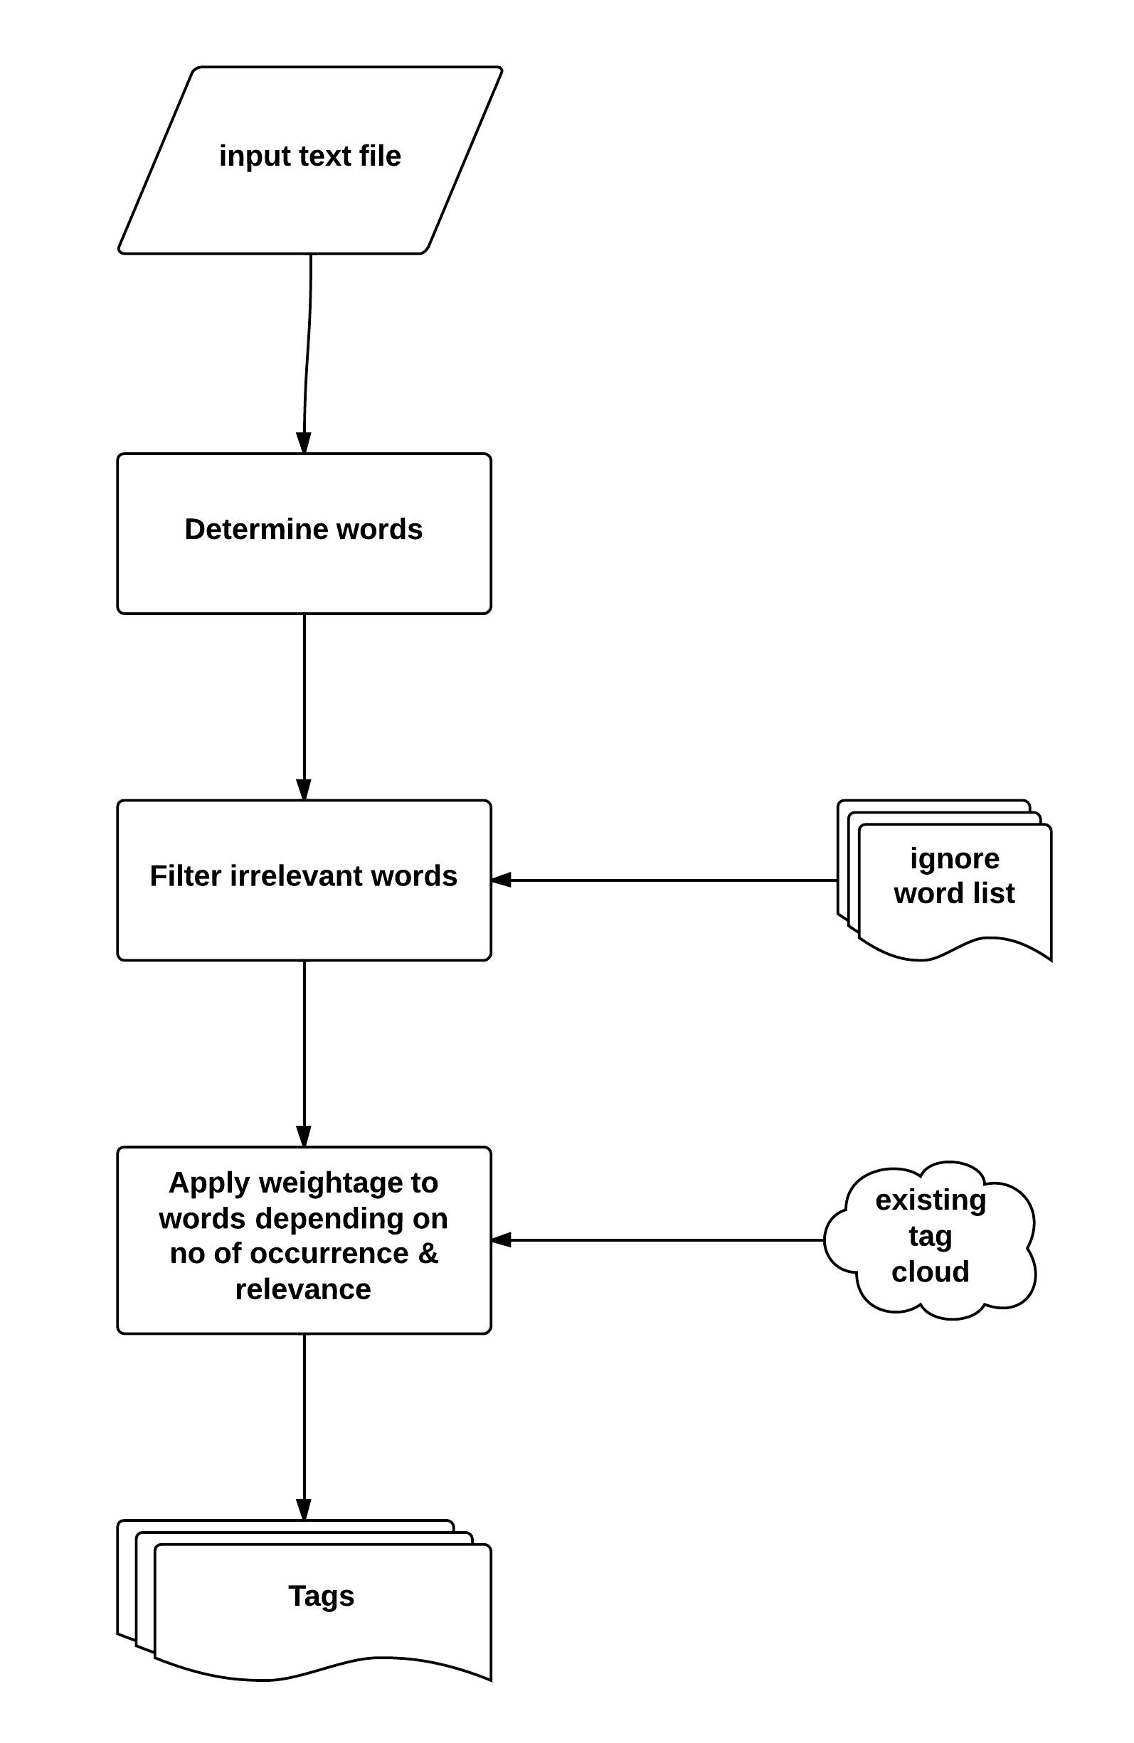
Tag
Determination
from
Recognized
Speech

Slide 22
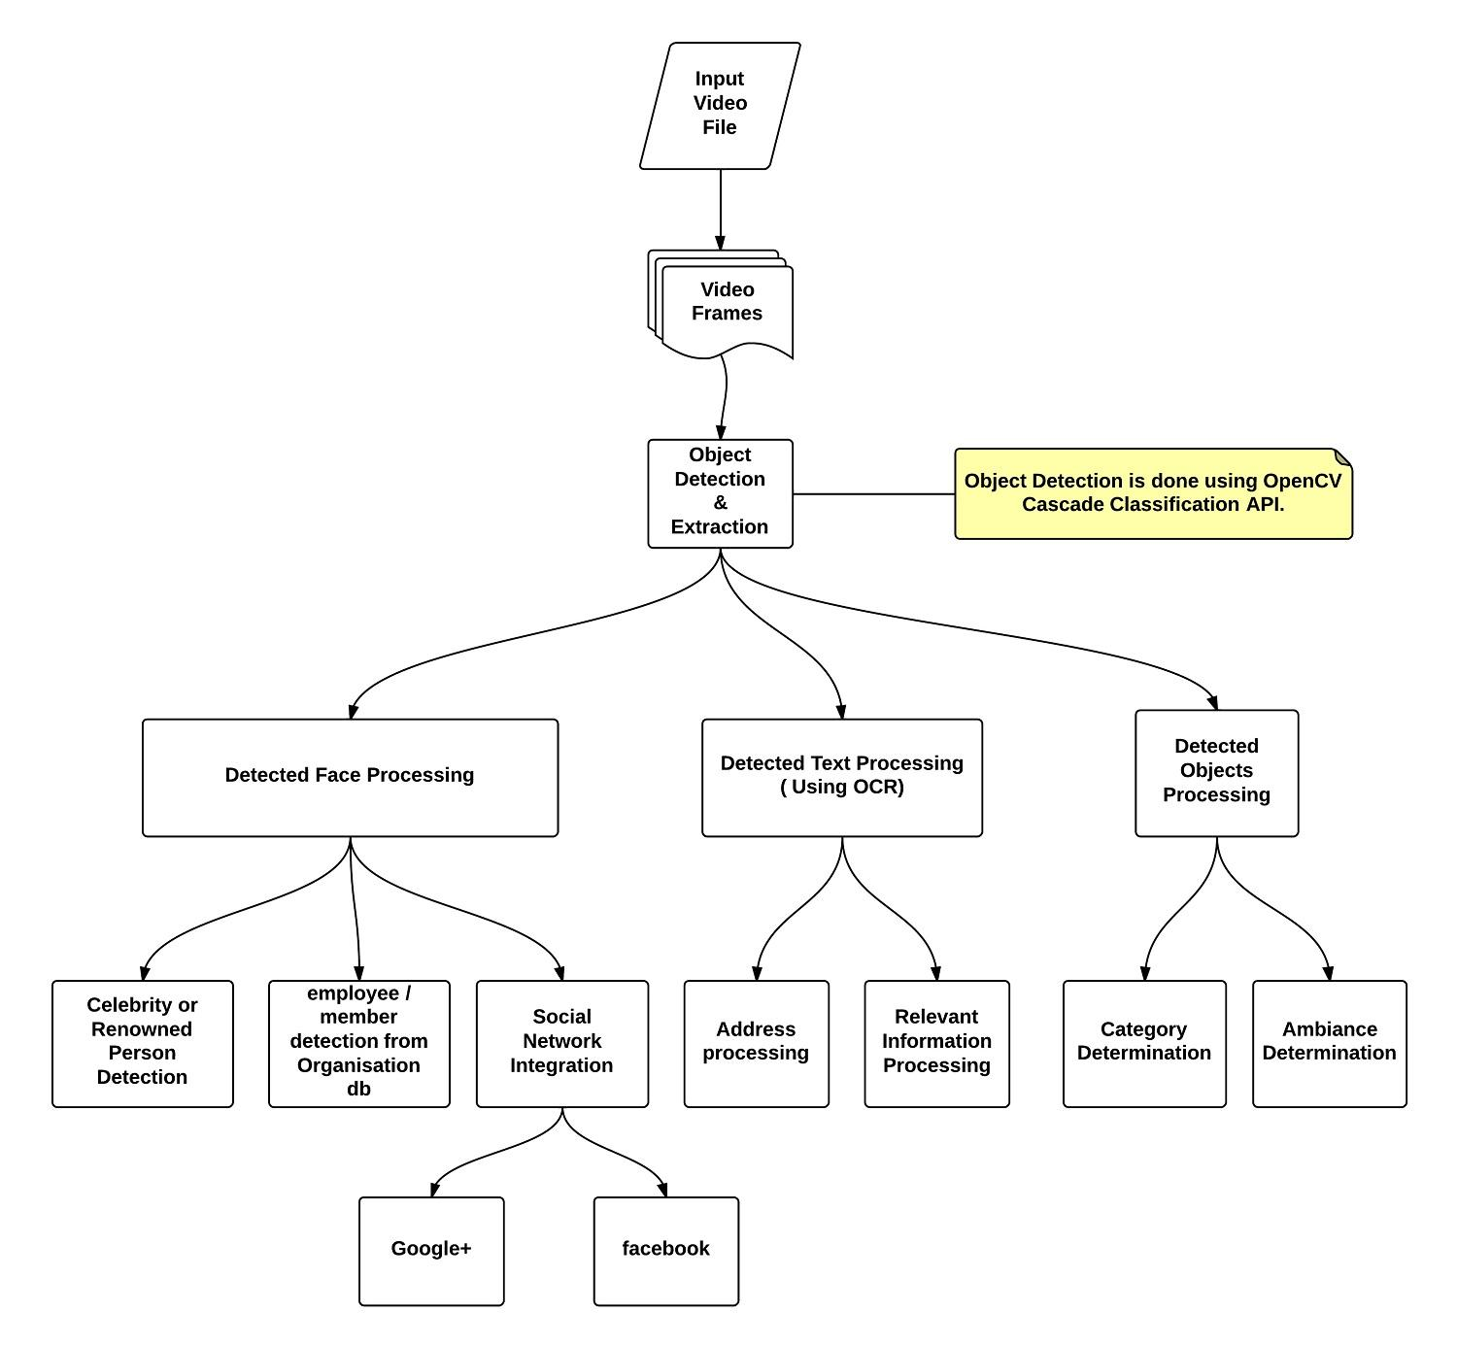
Object
Detect
From
Video
Frames

Slide 23
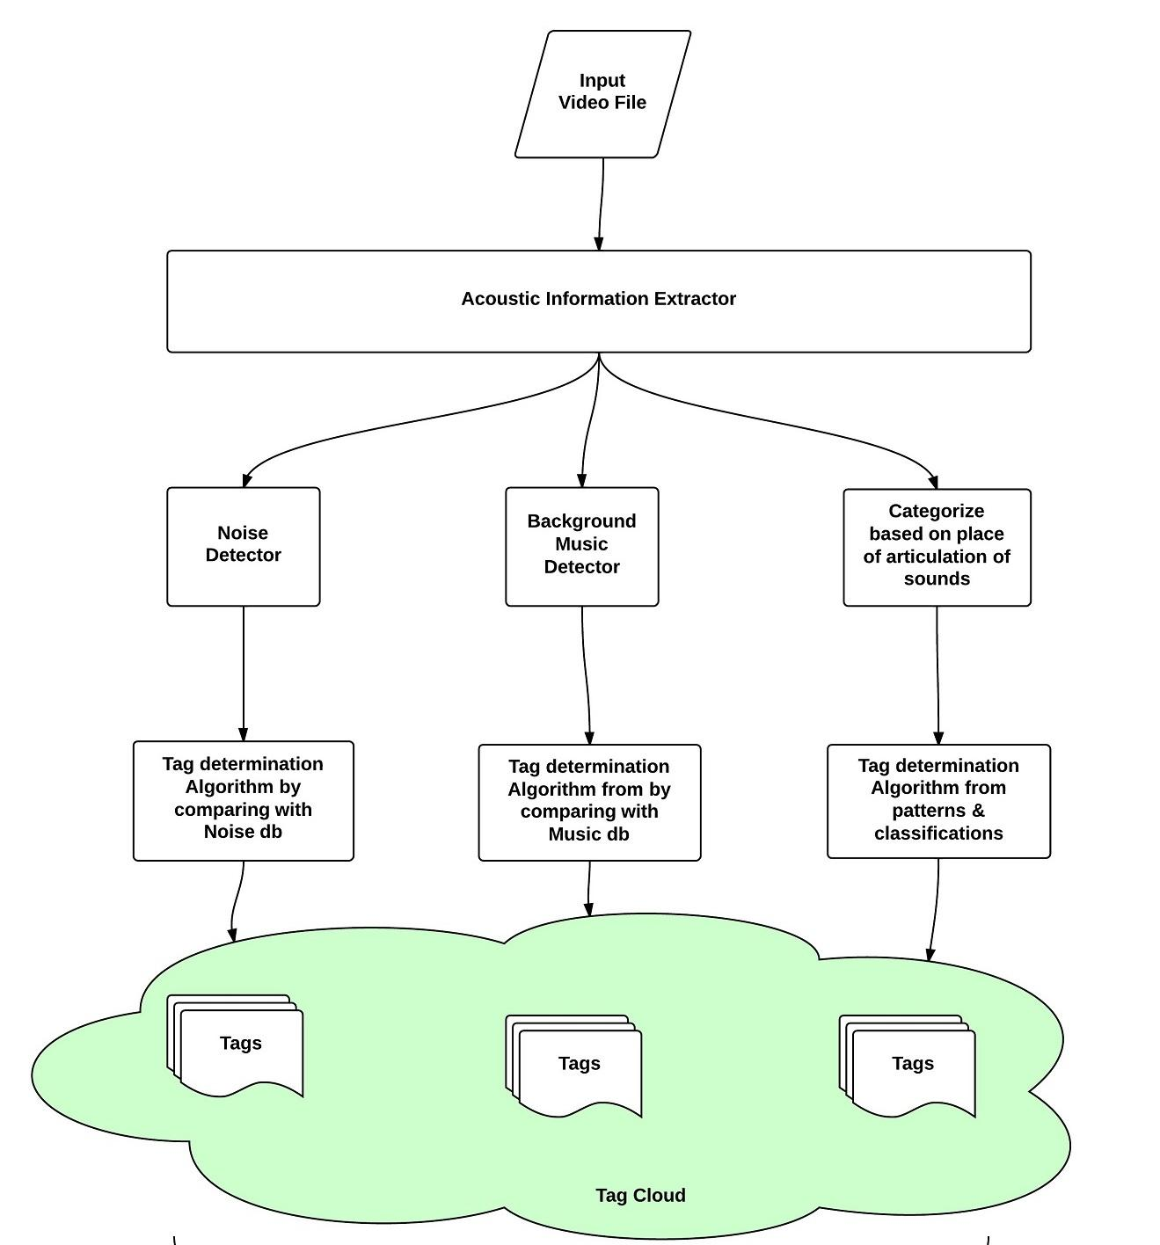
Acoustic
Information
Detect

Slide 24






Tools
MaART
Audacity
InCus
Wave Surfer
CAMEL
jAudio

Slide 25
Platforms
OpenCV
CMU Sphinx
MUVIS
Microsoft Audio Video Indexing Service (MAVIS)
HP Autonomy
Google Audio Indexing
Snack Sound Toolkit

Slide 26
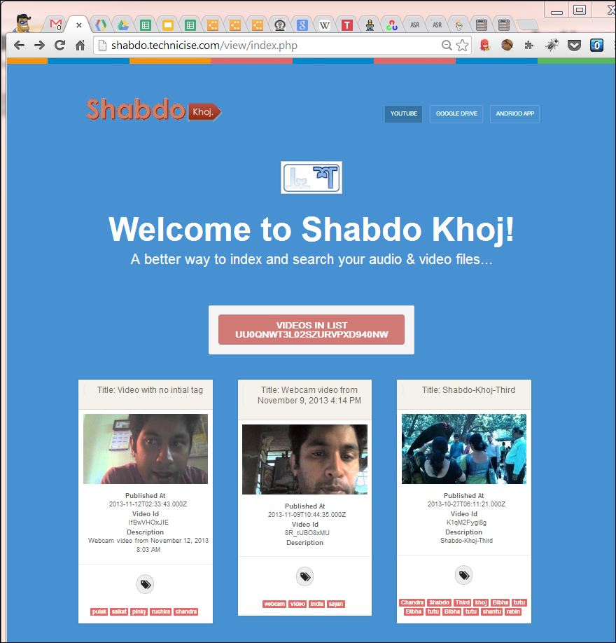
Work Done So Far
Video Access & Manual Indexing Prototype

Slide 27
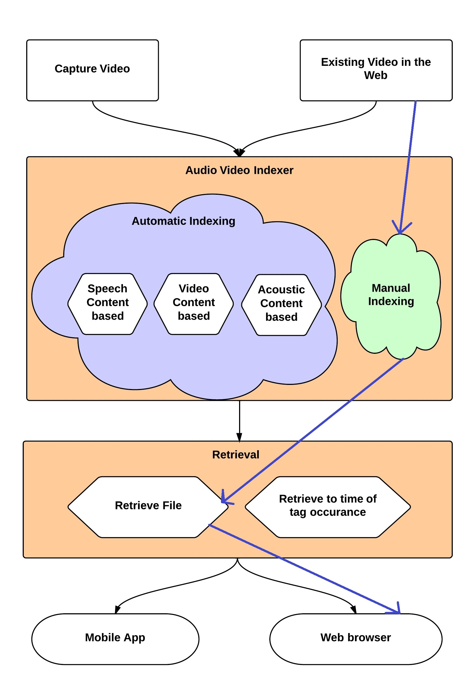
Work Done So Far
End to End flow implemented in 5th Sem

Slide 28
Algorithms & Workflow
Algorithm for determining index keys out of Recognized Speech Content
Workflow of Speech content & Image Object extraction
Overall framework for indexing audios/videos

Slide 29
Work In Progress
Image Object extraction
I am using OpenCV framework to detect image objects from video frames
Clients for Accessing Videos
Android App with above mentioned features
Desktop Uploader App with above mentioned features
Research newer index keys
Speaker Information as Index key
Acoustic information as index keys

Slide 30
Work to be done in 6th Sem
Use CMU Sphinx to extract speech content
One flow of Video Content Based Automatic Indexing(Extract Image Objects from video and tag celebrities present in a video)
One flow of Acoustic information Based Automatic Indexing
End to end Desktop Uploader App and Enhance Web Client for Indexing
Retrieve to time of tag occurrence

Slide 31
Future Scope
Integration With Dropbox & other video sharing website
Better retrieval process
Web Indexing database

Slide 32
References
http://www.speech.kth.se/snack/
http://research.microsoft.com/en-us/projects/mavis/
http://googlesystem.blogspot.in/2008/09/google-audio-indexing.html
http://en.wikipedia.org/wiki/Google_Audio_Indexing
http://googleblog.blogspot.in/2008/09/google-audio-indexing-now-on-google.html
http://www.autonomy.com/content/Technology/evolution/evolution-of-search/index.en.html
http://techcrunch.com/2008/09/17/google-launches-audio-indexing/
http://en.wikipedia.org/wiki/Multimedia_search
http://en.wikipedia.org/wiki/Audio_search_engine
http://www.playaudiovideo.com/pav_start.htm
http://www.ramp.com/
http://en.wikipedia.org/wiki/Google_Voice_Search
http://music.cs.northwestern.edu/index.php
http://www.aurix.com/pages/3417/Technology.htm
http://www.apple.com/ios/siri/
http://en.wikipedia.org/wiki/Siri_(software)
http://citeseerx.ist.psu.edu/viewdoc/summary?doi=10.1.1.161.913
http://www.apple.com/ios/siri/
http://www.vlingo.com/
http://muvis.cs.tut.fi/
http://www.speech.kth.se/wavesurfer/
http://audacity.sourceforge.net/
http://www.hongkiat.com/blog/25-free-digital-audio-editors/
https://incus.greenbutton.com/
http://maart.sourceforge.net/
https://sourceforge.net/projects/camel-framework/
https://sourceforge.net/projects/jaudio/
http://sourceforge.net/projects/segfried/
http://sourceforge.net/projects/fic/
http://sourceforge.net/projects/libxtract/
http://sourceforge.net/projects/yaafe/

Slide 33
Case Study (Problem)
2 days remaining for End Sem exam. Total time available for preparation is Maximum 30 hours.
30 x 3 = 90 video lectures available, which will take 90 hours to play.
Video titles are corrupted somehow. So it is not possible to identify the important lectures quickly.

Slide 34
Case Study ( Solution )
Indexing
Index the video files according to Speaker, Creation Time, Capture Location, Recognized Speech, Metadata etc.
Index videos by Image object , Image text, Background noise & Acoustic information
Create a tag cloud, determine suitable tags with file.

Slide 35
Case Study ( Solution )
Searching
Retrieve According to Speaker : Ksrao, Rsc, Sc
Retrieve According to Creation Time & Sort.
Retrieve According to Capture Location
Retrieve According to Recognized Speech content
Retrieve According to User defined metadata / tag
Retrieve According to Acoustic information.

Slide 36
References
http://sourceforge.net/projects/marsyas/?source=recommended
http://sourceforge.net/projects/espeak
http://sourceforge.net/projects/sp-tk/
http://www.phon.ucl.ac.uk/resource/sfs/audindex/
http://en.wikipedia.org/wiki/Acoustic_fingerprint
http://en.wikipedia.org/wiki/Shazam_(service)
http://en.wikipedia.org/wiki/Query_by_humming
http://www.midomi.com/
http://www.soundhound.com/
http://en.wikipedia.org/wiki/Tunebot
http://en.wikipedia.org/wiki/Musipedia
http://www.kecl.ntt.co.jp/csl/sirg/people/yasushi/SoundCompass.pdf
http://en.wikipedia.org/wiki/Parsons_code
http://music.cs.northwestern.edu/index.php
http://tunebot.cs.northwestern.edu/index.php
http://www.musipedia.org/
http://www.cisco.com/en/US/solutions/collateral/ns341/ns525/ns537/ns705/ns827/white_paper_c11-520862.html
http://mashable.com/2012/03/06/one-day-internet-data-traffic/
http://hadoop-karma.blogspot.in/2010/03/how-much-data-is-generated-on-internet.html
http://www.scientificpsychic.com/workbook/chapter2.htm
http://www.omg-facts.com/Technology/In-2010-Google-Had-Only-Indexed-004-Of-T/52586
http://googleblog.blogspot.in/2008/07/we-knew-web-was-big.html
http://idpl.oxfordjournals.org/content/2/2/47.extract
http://www.cisco.com/en/US/solutions/collateral/ns341/ns525/ns537/ns705/ns827/white_paper_c11-520862.html

Slide 37
Thank you.
Q & A
Thank You

